Slide 1
Predictive Modeling
Chapter 12: Discriminant Analysis and Other Linear Classification Models
STA 6543
The University of Texas at San Antonio

Slide 2
Overview
Part I: General Strategies
Part II: Regression Models
Chapter 6: Linear Regression and Its Cousins
Chapter 7: Nonlinear Regression Models
Chapter 8: Regression Trees and Rule-Based Models
Part III: Classification Models
Chapter 11: Measuring Performance in Classification Models
Chapter 12: Discriminant Analysis and Other Linear Classification Models
Chapter 13: Nonlinear Classification Models
Chapter 14: Classification Trees and Rule-Based Models

Slide 3
A further overview of classification
Classification problems occur often, perhaps even more so than regression problems. Some examples include:
A person arrives at the emergency room with a set of symptoms that could possibly be attributed to one of three medical conditions. Which of the three conditions does the individual have?
An online banking service must be able to determine whether a transaction being performed on the site is fraudulent, based on the user’s IP address, past transaction history, and so forth.
Based on DNA sequence data for a number of patients with and without a given disease, a biologist would like to figure out which DNA mutations are deleterious (disease-causing), and which are not.

Slide 4
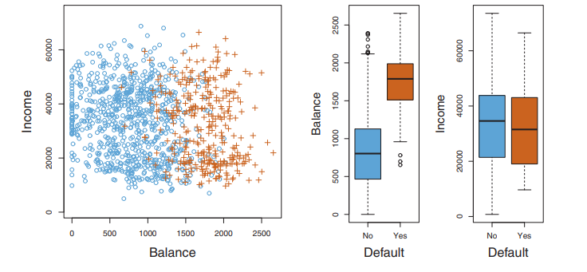
Credit card default data
Target: identify customers who are likely to default (Yes or No: binary response) given their monthly credit card balance (X₁) and annual incomes (X₂).

Slide 5
Classification regression models
Various types of classification models
Logistic regression
Linear discriminant analysis
Partial least squares discriminant analysis
Penalized models
Nearest shrunken centroids
R demonstrations for the stock market data

Slide 6
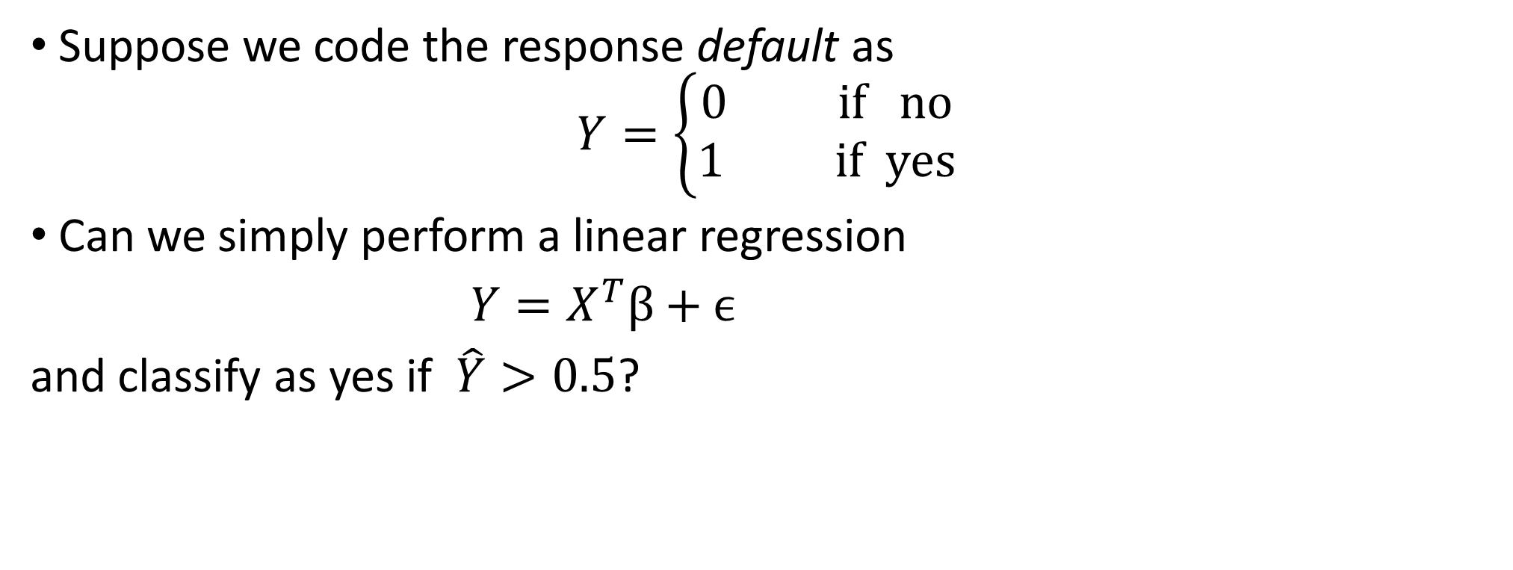
Why not linear regression?
Suppose we code the response default as
$$Y=\left\{\begin{matrix}0 if no \\ 1 if yes\end{matrix}\right.$$
Can we simply perform a linear regression
$Y=X^{T}β+ϵ$
and classify as yes if $\hat{Y}>0.5$?

Slide 7
Why not linear regression?
For a binary response with a 0/1 coding, linear regression does make sense, and it is equivalent to linear discriminant analysis.
Problems:
Some of our estimates might be outside the [0, 1] interval, making them hard to interpret as probabilities.
Cannot be easily extended to accommodate more than two levels.

Slide 8
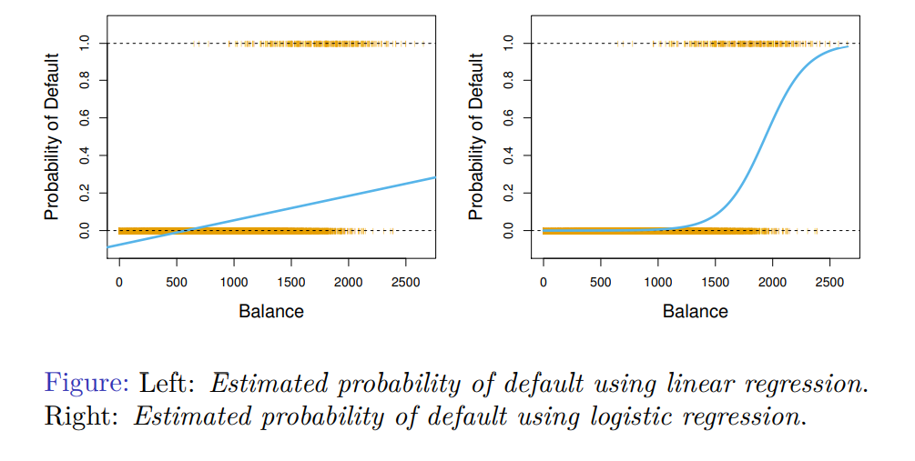
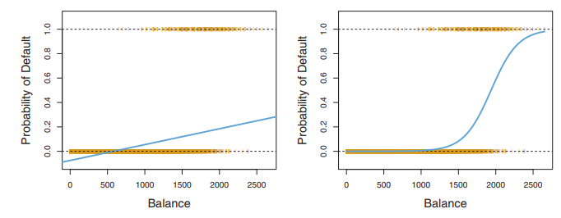
Linear regression on default data
Linear regression provides some negative estimated probabilities. Logistic regression seems well suited to the task.

Slide 9
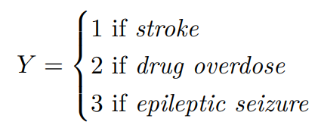
Linear regression for more than two levels
Suppose we want to predict the medical condition of a patient in the emergency room on the basis of her symptoms. There are three possible values on the response: stroke, drug overdose, and epileptic seizure. Consider the following coding:

Slide 10
Linear regression for more than two levels
Unfortunately, this coding implies an ordering, insisting that the difference between stroke and drug overdose is the same as between drug overdose and epileptic seizure.
A different coding could end up with a totally different relationship among the three conditions, leading to fundamentally different linear models.
Therefore, linear regression is not appropriate here.

Slide 11
Logistic regression
Chapter 12: Discriminant Analysis and Other Linear Classification Models

Slide 12
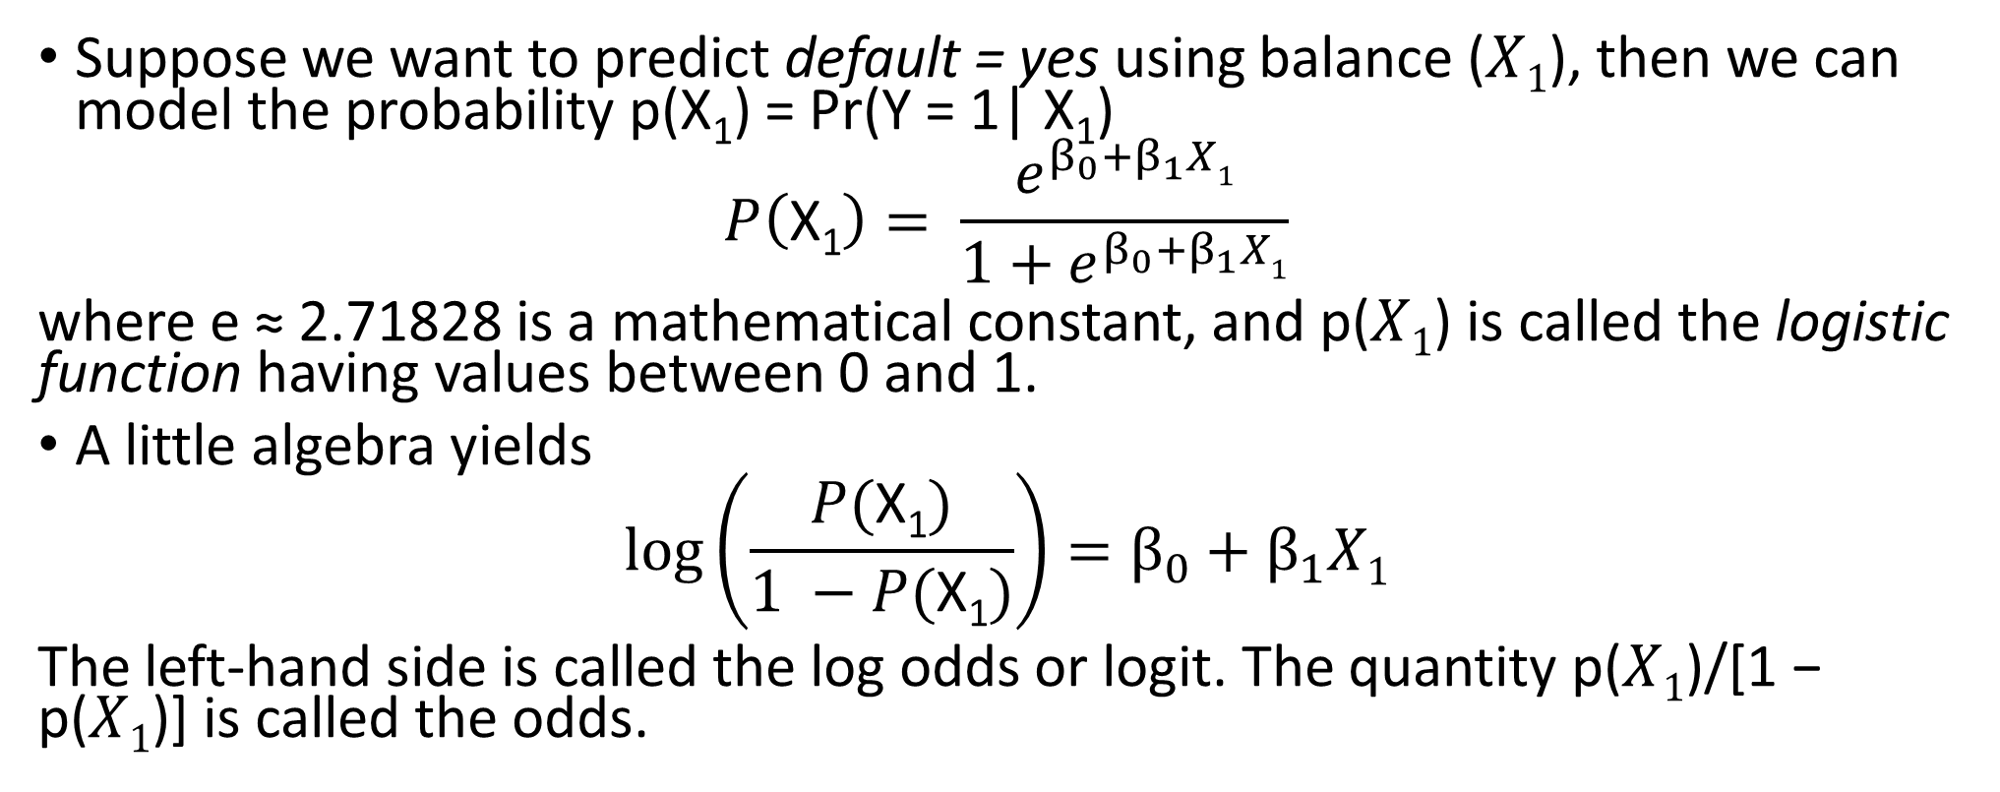
Logistic regression
Suppose we want to predict default = yes using balance ($X1$), then we can model the probability p(X₁) = Pr(Y = 1| X₁)
$$P\left(\text{X}\text{1}\right)= \frac{e^{β_{0}+β_{1}X1}}{1+e^{β_{0}+β_{1}X1}}$$
where e ≈ 2.71828 is a mathematical constant, and p($X1$) is called the logistic function having values between 0 and 1.
A little algebra yields
$$log\left(\frac{P(\text{X}\text{1})}{1 −P(\text{X}\text{1})}\right)=β_{0}+β_{1}X1$$
The left-hand side is called the log odds or logit. The quantity p($X1$)/[1 − p($X1$)] is called the odds.

Slide 13
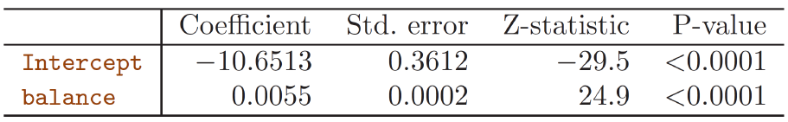
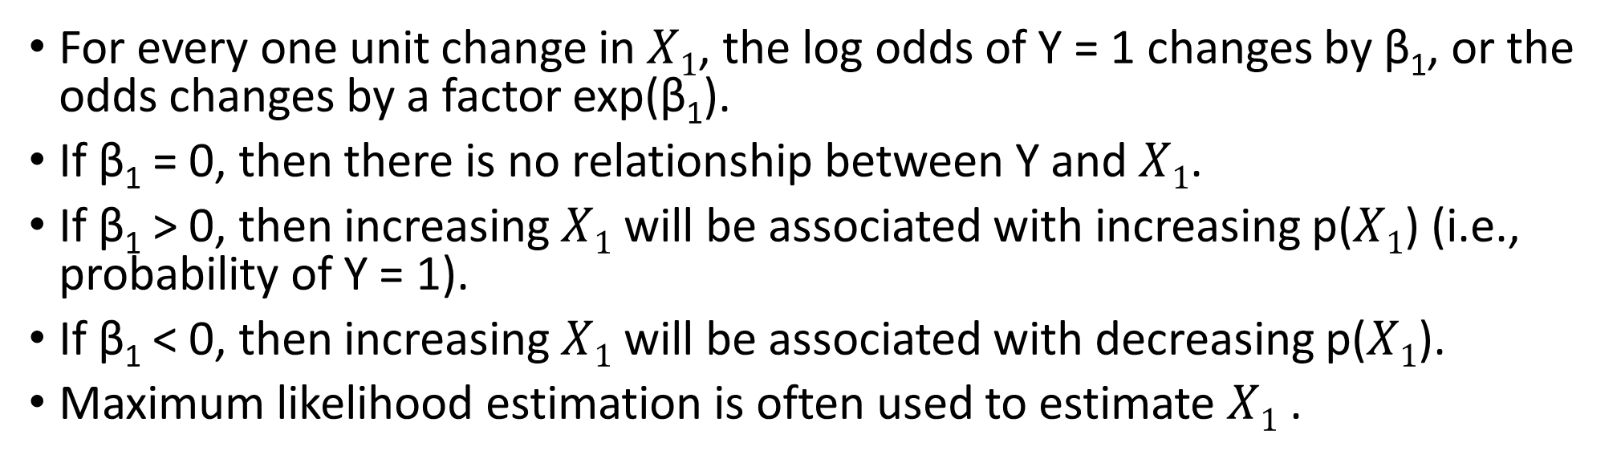
Interpretation of β₁
For every one unit change in $X1$, the log odds of Y = 1 changes by β₁, or the odds changes by a factor exp(β₁).
If β₁ = 0, then there is no relationship between Y and $X1$.
If β₁ > 0, then increasing $X1$ will be associated with increasing p($X1$) (i.e., probability of Y = 1).
If β₁ < 0, then increasing $X1$ will be associated with decreasing p($X1$).
Maximum likelihood estimation is often used to estimate $X1$ .

Slide 14
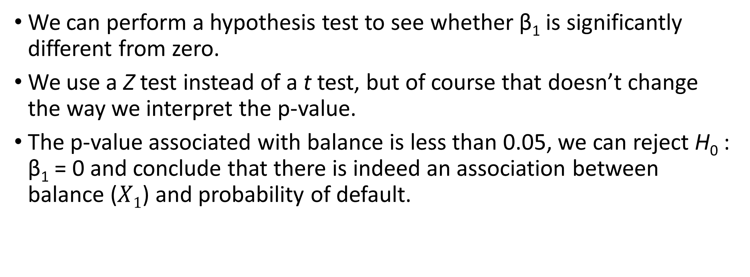
Are the coefficients significant?
We can perform a hypothesis test to see whether β₁ is significantly different from zero.
We use a Z test instead of a t test, but of course that doesn’t change the way we interpret the p-value.
The p-value associated with balance is less than 0.05, we can reject H₀ : β₁ = 0 and conclude that there is indeed an association between balance ($X1$) and probability of default.

Slide 15

Interpretation of β₁
The $\hat{\text{β}\text{1}}=0.0055$indicates that a one dollar increase in balance is associated with an increase in the log odds of default by 0.0055 units.

Slide 16
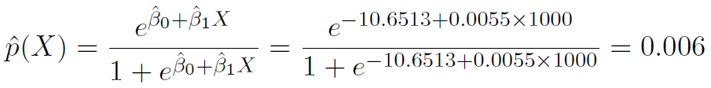
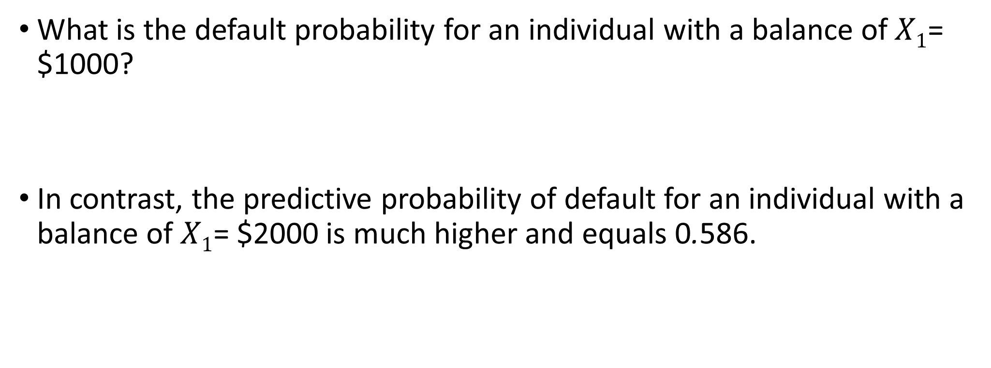
Making predictions
What is the default probability for an individual with a balance of $X1$= $1000?
In contrast, the predictive probability of default for an individual with a balance of $X1$= $2000 is much higher and equals 0.586.
1
1
1

Slide 17
Other considerations in logistic regression
Analyzing rare events with logistic regression (link).
Diagnostics and model checking for logistic regression (link).
We use maximum likelihood estimation to train logistic regression. In machine learning, stochastic gradient ascent is often used (link)

Slide 18
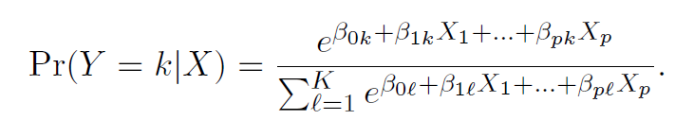
Logistic regression for > 2 response classes
Sometimes we wish to classify a response variable that has more than two classes. In this case, one multiple-class extension is
This form is used in the R package glmnet.
When response classes are ordered, e.g., “poor”, “fair”, “good”, the ordinal logistic regression can be used.

Slide 19
The stock market data
The stock market data is from the ISLR library.
This data set consists of percentage returns for the S&P 500 stock index over 1250 days, from the beginning of 2001 until the end of 2005.
For each date, we have recorded the percentage returns for each of the five previous trading days, Lag1 through Lag5.
We have also recorded Volume (the number of shares traded on the previous day, in billions), Today (the percentage return on the date in question) and Direction (whether the market was Up or Down on this date: Response is binary).

Slide 20
The stock market data
# required packages library(AppliedPredictiveModeling) library(caret) library(ISLR) #the stock market data library(pROC) #roc library(MASS) #lda library(glmnet) ### The Stock Market Data #### head(Smarket) names(Smarket) dim(Smarket) summary(Smarket); cor(Smarket); # pairwise correlations for numerical predictors cor(Smarket[,-9]); ## The only substantial correlation is between Year and Volume. attach(Smarket) plot(Volume);

Slide 21
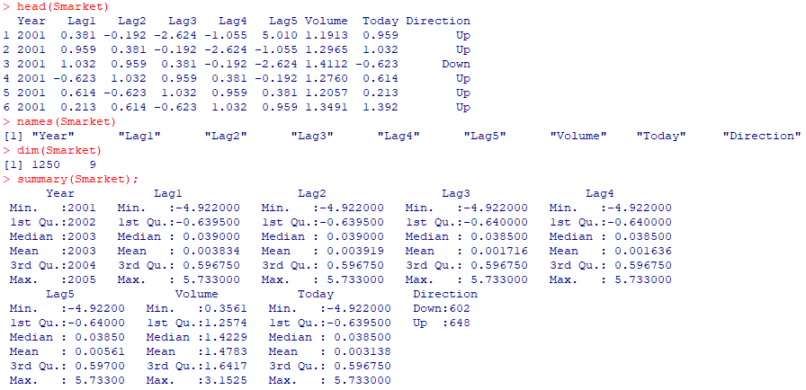
Data information

Slide 22
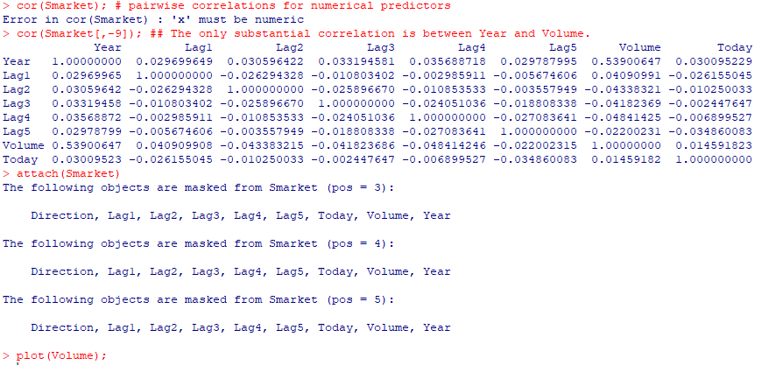
Data information
As one would expect, the correlations between the lag variables and today’s returns are close to zero. In other words, there appears to be little correlation between today’s returns and previous days’ returns.

Slide 23
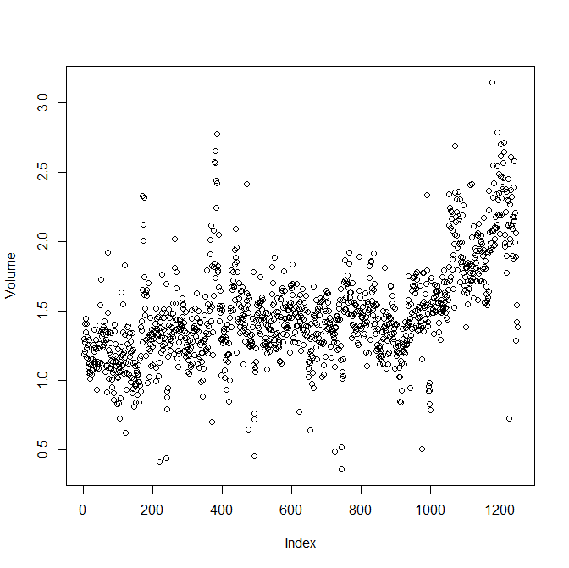
Data information
The only substantial correlation is between Year and Volume. We see from the above plot that Volume is increasing over time. In other words, the average number of shares traded daily increased from 2001 to 2005.

Slide 24
Data splitting
###Data splitting train = which(Year<2005) Smarket.train= Smarket[train,]; # observations before 2005 are served as test data. Smarket.test= Smarket[-train,]; # observations from 2005 are served as test data.

Slide 25
Train control function
### Create a control function that will be used across models. set.seed(100) ctrl <- trainControl(method = "LGOCV", summaryFunction = twoClassSummary, classProbs = TRUE, savePredictions = TRUE) # LGOCV: Repeated Train/Test Splits Estimated (25 reps, 75%)

Slide 26
Logistic regression
set.seed(476) logisticTune <- train(x = as.matrix(Smarket.train[,1:8]), y = Smarket.train$Direction, method = "glm", metric = "ROC", trControl = ctrl) logisticTune ### Save the test set results in a data frame testResults <- data.frame(obs = Smarket.test$Direction, logistic = predict(logisticTune, Smarket.test))

Slide 27
Roc curve of the logistic regression
library(pROC) ### Predict the test set based the logistic regression Smarket.test$logistic <- predict(logisticTune,Smarket.test, type = "prob")[,1] #ROC for logistic model logisticROC <- roc(Smarket.test$Direction, Smarket.test$logistic) plot(logisticROC, col=1, lty=1, lwd=2) #Confusion matrix of logistic model confusionMatrix(data = predict(logisticTune, Smarket.test), reference = Smarket.test$Direction)

Slide 28
ROC curve of the logistic regression

Slide 29
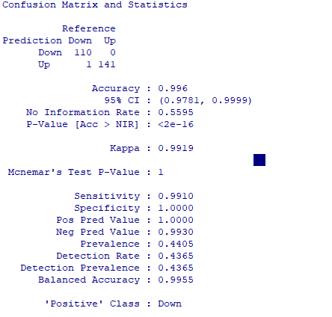
Confusion matrix

Slide 30
Linear discriminant analysis
Chapter 12: Discriminant Analysis and Other Linear Classification Models

Slide 31
Why discriminant analysis?
When the classes are well-separated, the parameter estimates for the logistic regression model are surprisingly unstable. Linear discriminant analysis does not suffer from this problem.
If n is small and the distribution of the predictors is approximately normal in each of the classes, the linear discriminant model is again more stable than the logistic regression model.
Linear discriminant analysis is popular when we have more than two response classes, because it also provides low-dimensional views of the data.

Slide 32
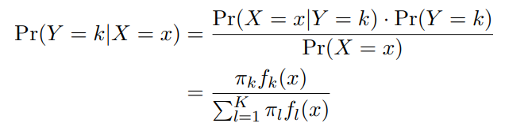
Bayes’ theorem for classification
Suppose Y can take on K possible distinct values, denoted by C = {1, 2, . . . , K}. Bayes’ theorem states that
where π_{k} = Pr(Y = k) is the overall or prior probability of coming from class k. f_{k} (x) = Pr(X = x | Y = k) is the density for X given that X = x is from class k.

Slide 35

A two-group classification problem
For a two-group classification problem, the rule that minimizes the total probability of misclassification would be to classify X into group 1 if π₁f₁ (x) > π₂f₂ (x) and into group 2 if the inequality is reversed.
We assume that f_{k}(x) is normal (or Gaussian). The Gaussian density has the form
where µ_{k} and σ²_{k} are the mean and variance for the class k. For now, we assume that all the σ²_{k} = σ² are the same.

Slide 38

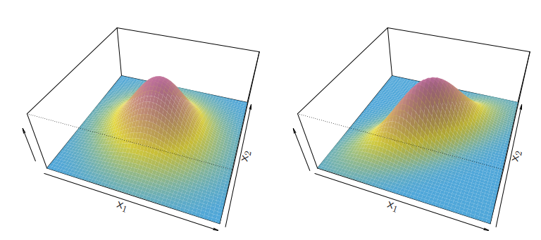
Linear discriminant analysis for p > 1
We model X using multivariate Gaussian
where µ_{k} is the mean of X in class k, and Σ = Cov(X) is its covariance matrix.

Slide 39
LDA
set.seed(476) ldaTune <- train(x = as.matrix(Smarket.train[,1:8]), y = Smarket.train$Direction, method = "lda", preProc = c('center', 'scale'), metric = "ROC", trControl = ctrl) ldaTune ### Save the test set results in a data frame testResults$LDA <- predict(ldaTune, Smarket.test)

Slide 40
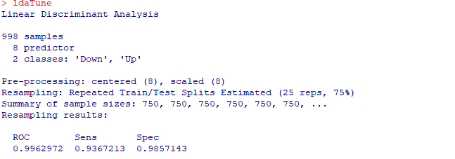
LDA output

Slide 41
Partial least squares discriminant analysis
Chapter 12: Discriminant Analysis and Other Linear Classification Models

Slide 42
Partial least squares discriminant analysis
PLSDA can be performed using the plsr function within the pls package by using a categorical matrix which defines the response categories.
The caret package contains a function (plsda) that can create the appropriate dummy variable PLS model for the data and then post-process the raw model predictions to return class probabilities.
The syntax is very similar to the regression model code for PLS that we discussed in Chapter 6.

Slide 43
Partial least squares discriminant analysis
set.seed(476) plsdaTune <- train(x = Smarket.train[,1:8], y = Smarket.train$Direction, method = "pls", tuneGrid = expand.grid(.ncomp = 1:5), trControl = ctrl) ### Save the test set results in a data frame testResults$plsda <- predict(plsdaTune, Smarket.test)

Slide 44
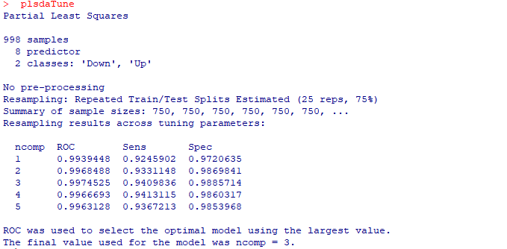
PLSDA output

Slide 45
Penalized models
Chapter 12: Discriminant Analysis and Other Linear Classification Models

Slide 46
Penalized models
The primary package for penalized logistic regression is glmnet.
The glmnet function is very similar to the enet function described previously in Chapter 6.
The main arguments correspond to the data: x is a matrix of predictors and y is a factor of classes (for logistic regression).
The family argument is related to the distribution of the outcome. For two classes, using family="binomial" corresponds to logistic regression, and, when there are three or more classes, family="multinomial" is appropriate.

Slide 47
Penalized models
The function will automatically select a sequence of values for the amount of regularization, although the user can select their own values with the lambda option.
Recall that the type of regularization is determined by the mixing parameter α.
glmnet defaults this parameter to alpha = 1, corresponding to a complete lasso penalty

Slide 48
Penalized models with the train function
glmnGrid <- expand.grid(.alpha = c(0, .1, .2, .4, .6, .8, 1), .lambda = seq(.01, .2, length = 40)) set.seed(476) glmnTune <- train(as.matrix(Smarket.train[,1:8]), y = Smarket.train$Direction, method = "glmnet", tuneGrid = glmnGrid, metric = "ROC", trControl = ctrl) plot(glmnTune) ### Save the test set results in a data frame testResults$glmn <- predict(glmnTune, Smarket.test)

Slide 50
Nearest Shrunken Centroids
Chapter 12: Discriminant Analysis and Other Linear Classification Models

Slide 51
Nearest Shrunken Centroids
The nearest-shrunken centroid model (also known as PAM, for predictive analysis for microarrays) is a linear classification model that is well suited for high-dimensional problems.
The nearest shrunken centroid method has one tuning parameter: shrinkage.
This model works well for problems with a large number of predictors since it has built-in feature selection that is controlled by the shrinkage tuning parameter.

Slide 52
Nearest Shrunken Centroids in R
nscGrid <- data.frame(.threshold = 0:25) nscTune <- train(x = as.matrix(Smarket.train[,1:8]), y = Smarket.train$Direction, method = "pam", preProc = c("center", "scale"), tuneGrid = nscGrid, metric = "ROC", trControl = ctrl) plot(nscTune) #variale importance plot(varImp(nscTune, scale = TRUE)) ### Save the test set results in a data frame testResults$NSC <- predict(nscTune, Smarket.test)

Slide 53
Nearest Shrunken Centroids

Slide 54
The variable importance

Slide 55
Model comparison with ROC and Confusion Matrix
Chapter 12: Discriminant Analysis and Other Linear Classification Models

Slide 56
Prediction based on different models
### Predict the test set based on five models #logistic Smarket.test$logistic <- predict(logisticTune,Smarket.test, type = "prob")[,1] #LDA Smarket.test$lda <- predict(ldaTune,Smarket.test, type = "prob")[,1] #PLSDA Smarket.test$plsda <- predict(plsdaTune,Smarket.test, type = "prob")[,1] #Penalized model Smarket.test$glmn <- predict(glmnTune,Smarket.test, type = "prob")[,1] #NSC Smarket.test$nsc <- predict(nscTune,Smarket.test, type = "prob")[,1]

Slide 57
#ROC for logistic model logisticROC <- roc(Smarket.test$Direction, Smarket.test$logistic) plot(logisticROC, col=1, lty=1, lwd=2) #ROC for LDA ldaROC <- roc(Smarket.test$Direction, Smarket.test$lda) lines(ldaROC, col=2, lty=2, lwd=2) #ROC for PLSDA plsdaROC <- roc(Smarket.test$Direction, Smarket.test$plsda) lines(plsdaROC, col=3, lty=3, lwd=2) #ROC for penalized model plsdaROC <- roc(Smarket.test$Direction, Smarket.test$glmn) lines(plsdaROC, col=4, lty=4, lwd=2) #ROC for NSC plsdaROC <- roc(Smarket.test$Direction, Smarket.test$nsc) lines(plsdaROC, col=5, lty=5, lwd=2) legend('bottomright', c('logistic','lda','plsda','penalized model', 'nsc'), col=1:5, lty=1:5,lwd=2)

Slide 58
Roc curves of different models

Slide 59
Confusion matrices of different models
#Confusion matrix of logistic model confusionMatrix(data = predict(logisticTune, Smarket.test), reference = Smarket.test$Direction) #Confusion Matrix of lda model confusionMatrix(data = predict(ldaTune, Smarket.test), reference = Smarket.test$Direction) #Confusion matrix of partial least squares discriminant analysis confusionMatrix(data = predict(plsdaTune, Smarket.test), reference = Smarket.test$Direction) #Confusion matrix of penalized models confusionMatrix(data = predict(glmnTune, Smarket.test), reference = Smarket.test$Direction) #Confusion matrix of nearest shrunken centroids confusionMatrix(data = predict(nscTune, Smarket.test), reference = Smarket.test$Direction)

Slide 60
Summary of output
Model | Accuracy | Kappa | Sensitivity | Specificity
Logistic | 0.9960 | 0.9919 | 0.9910 | 1.0000
LDA | 0.9524 | 0.9025 | 0.9009 | 0.9929
PLSDA | 0.9405 | 0.8775 | 0.8649 | 1.0000
Penalized model | 0.9841 | 0.9677 | 0.9640 | 1.0000
NSC | 0.9524 | 0.9023 | 0.8919 | 1.0000

Slide 61
Model comparisons based on resamples of Training data
#Resamples of Tranining data res = resamples(list(Logistic = logisticTune, LDA =ldaTune,PLSDA = plsdaTune, Penalized = glmnTune, NSC = nscTune )) dotplot(res) #dotplot(res,metric="ROC")

